Slide 1

Data Analysis of Magist
Eniac Ltda.
Alex
Aisan
Marc
Armin

Slide 2
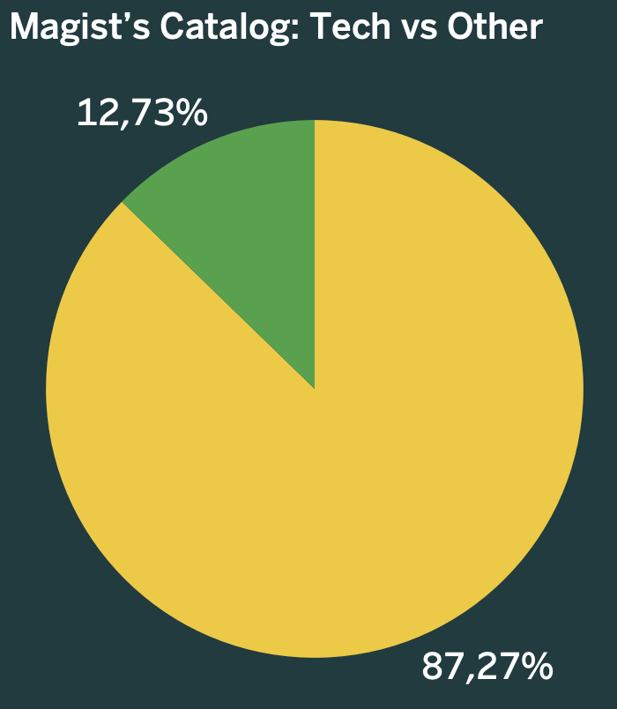
Only 12.7% of listings are tech-related.
Magist’s core focus is general consumer goods, not technology.
Still offers broad reach for testing market entry in Brazil.

Slide 3
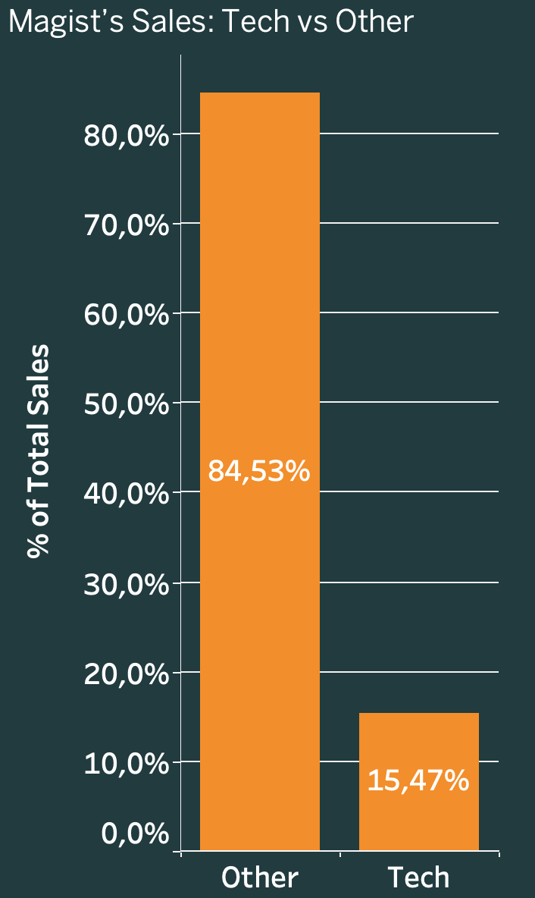
Tech products account for 15.47% of total sales.
Customer spend clusters in low- to mid-price brackets
sales frequency for tech products is 5–6 × lower than other items

Slide 4
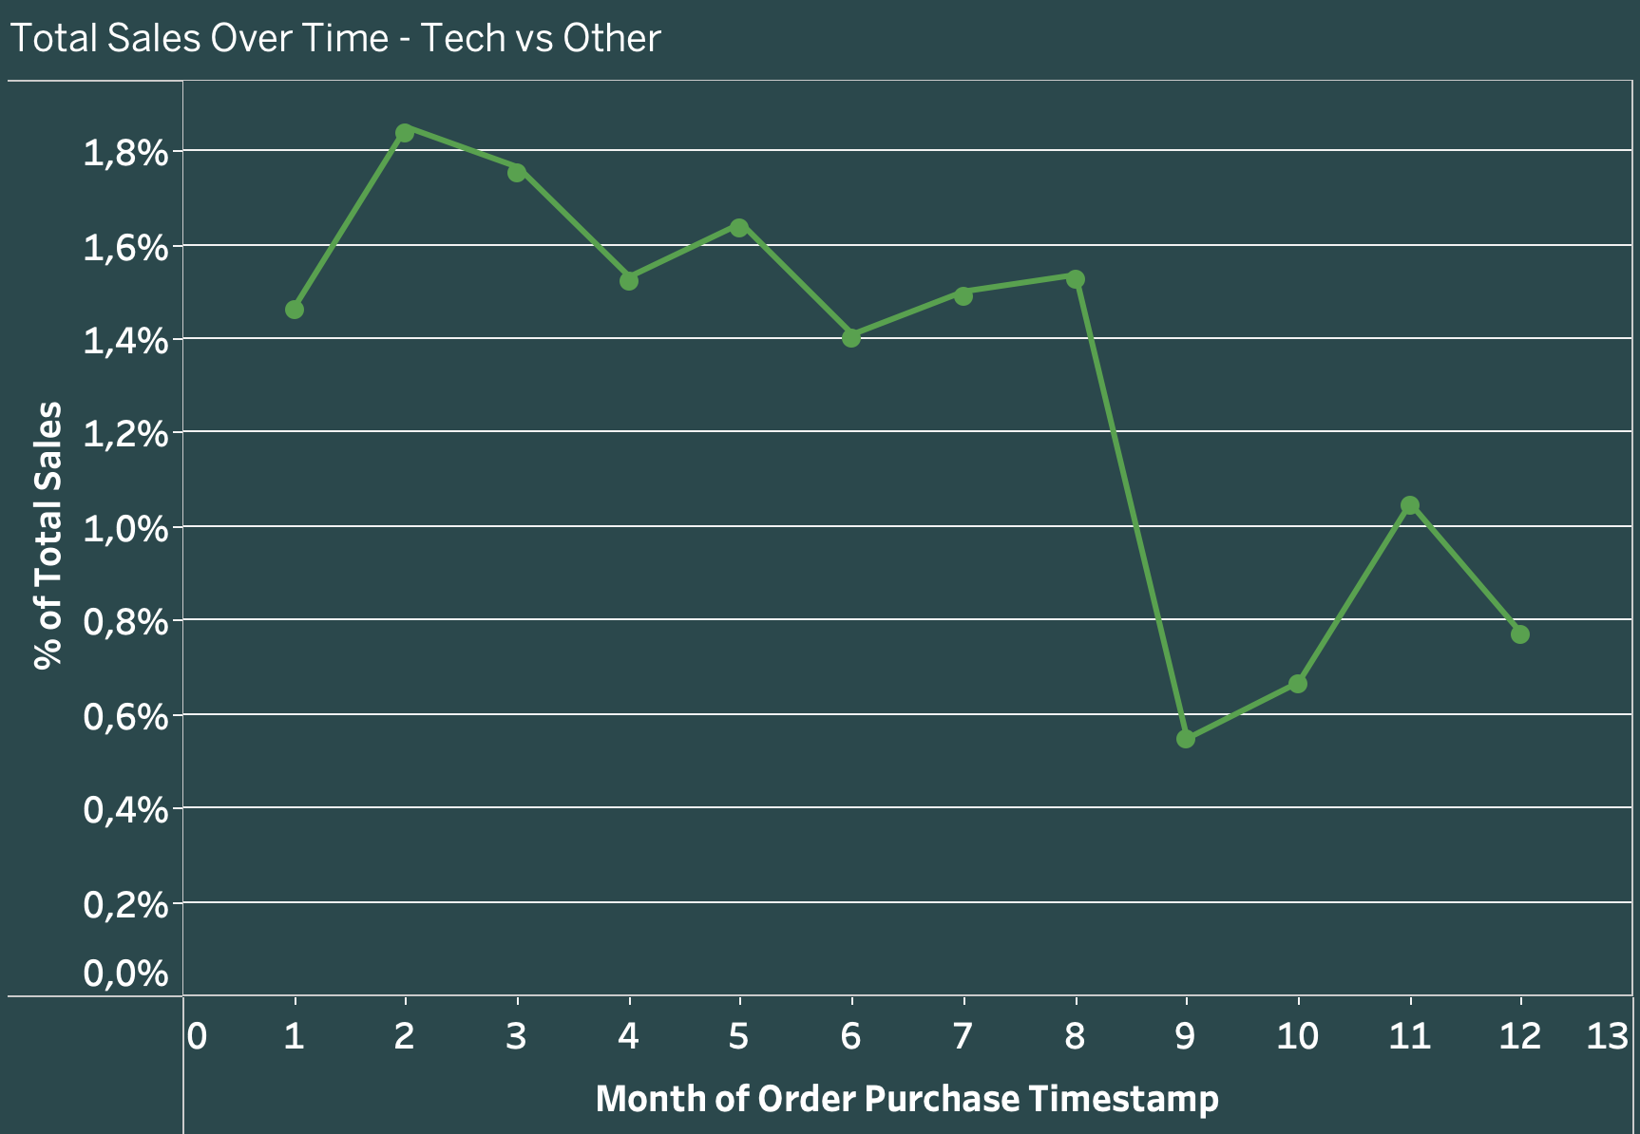
Tech share remains flat across the two-year period.
Non-tech products dominate with ≈ 85–90 % of total orders each month.

Slide 5
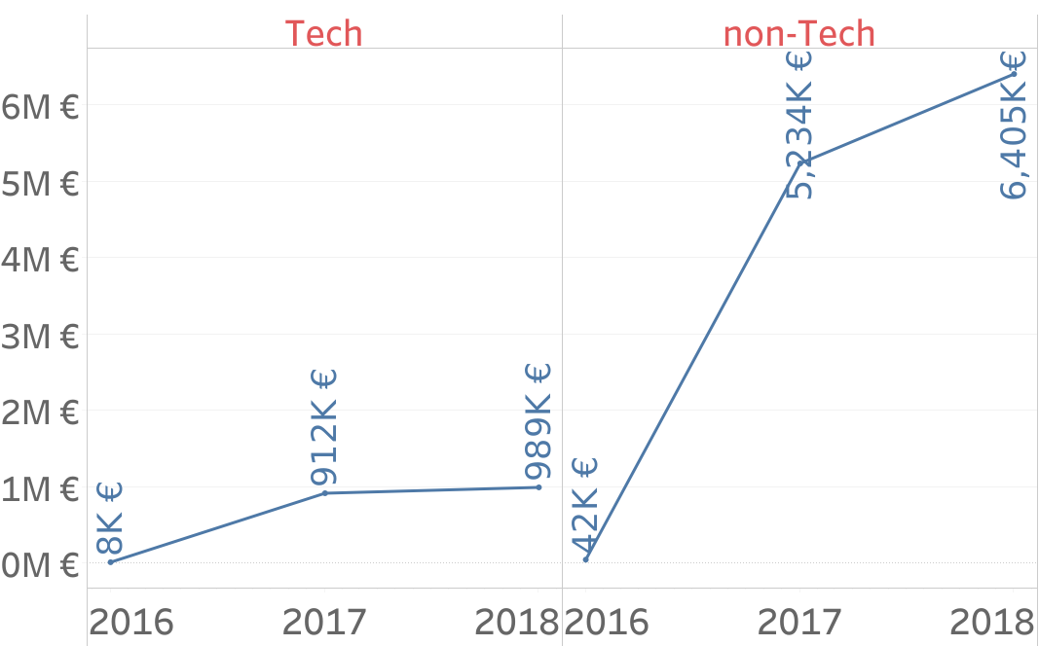
Sale Performance
Duration: 26 months
Total Seller : 3095
Revenue: 13,6M €
Avg Monthly Rev:577K €
Tech Sellers: 515 (16,64 %)
Tech Revenue:1,96M €
Tech Avg Monthly Rev:80k €

Slide 6
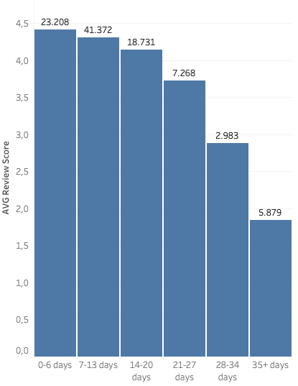
The "Human Touch" Gap: Fulfillment Impacts Loyalty
POST-PURCHASE ANALYSIS
Key learning 1
Delivery Speed is the #1 Driver
Our "warmhearted spirit" is undermined by slow fulfillment. There is a clear, negative correlation between delivery time and customer review scores.
Key learning 2
Customers who experience slow fulfillment are highly unlikely to become loyal repeat buyers. Satisfaction drops from "Excellent" (4.41) to "Poor" (2.83) when delivery exceeds 5 weeks.

Slide 7
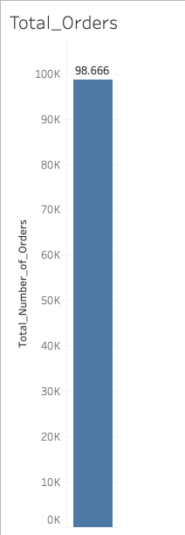
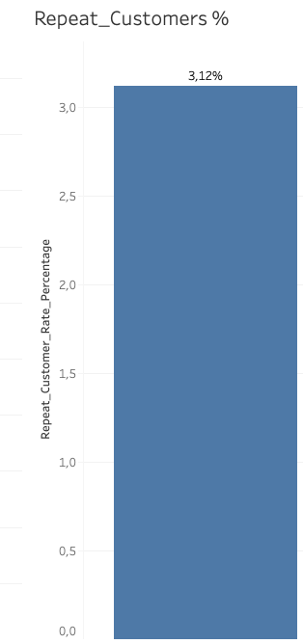
POST-PURCHASE ANALYSIS
Initial Insight: High Transactional Volume, Low Loyalty
Key learning 1
Magist has successfully acquired a large volume of customers, showing steady growth through the data period. However, the subsequent behavior suggests these are one-time buyers rather than repeat patrons.
Point to the gap your product will fill and explain how your business can claim that space.
Key learning 2
CRITICAL METRIC: 3.12% Low Customer Retention This rate indicates the platform fails to foster the customer loyalty that is fundamental to eniac's "human touch" philosophy. Scaling transactions without building retention presents long-term instability.

Slide 8
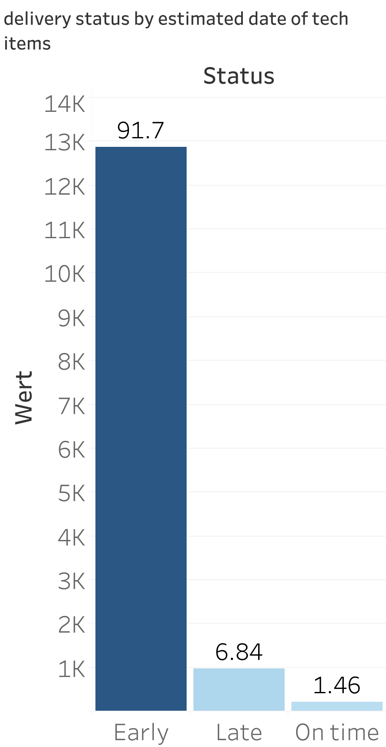
Overview
Avg delivery time is 12.5 days
93% of deliveries arrive on-time or early
7% of deliveries are delayed
The average delivery times improved by 38% overall and by 21% for tech products from 2016 to 2018
ENIAC - Delivery Performance

Slide 9

Median delivery time is 11 days
The 90th percentile worst case scenario for most customers is 23 days
Magist's 12.5 day average meets Brazilian e-commerce standards
4-15 day range
ENIAC - Delivery Performance
Source: techinbrazil.com
April 2015

Slide 10

Yes, but
Our Recommendation
Should we cooperate with Magist?
Start with a testing phase of one year
Focus on Sao Paulo
Team Banana Split

